Slide 1


COMPANY
PRESENTATION
Ngen: Your bridge to energy self-sufficiency.

Slide 2

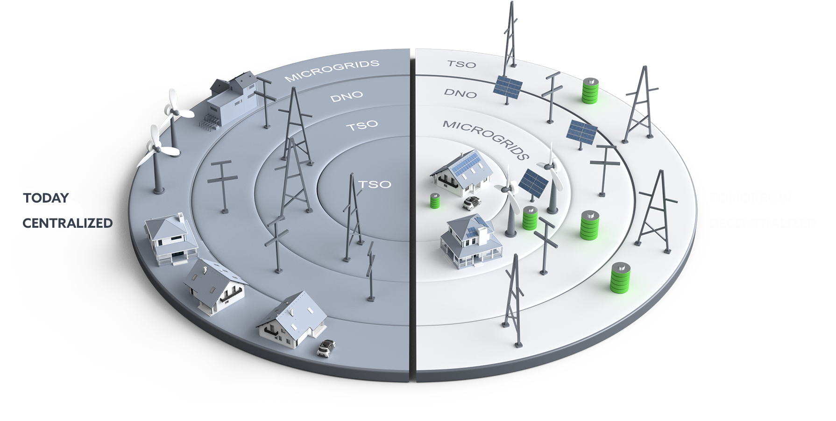
TODAY vs TOMORROW

Slide 3
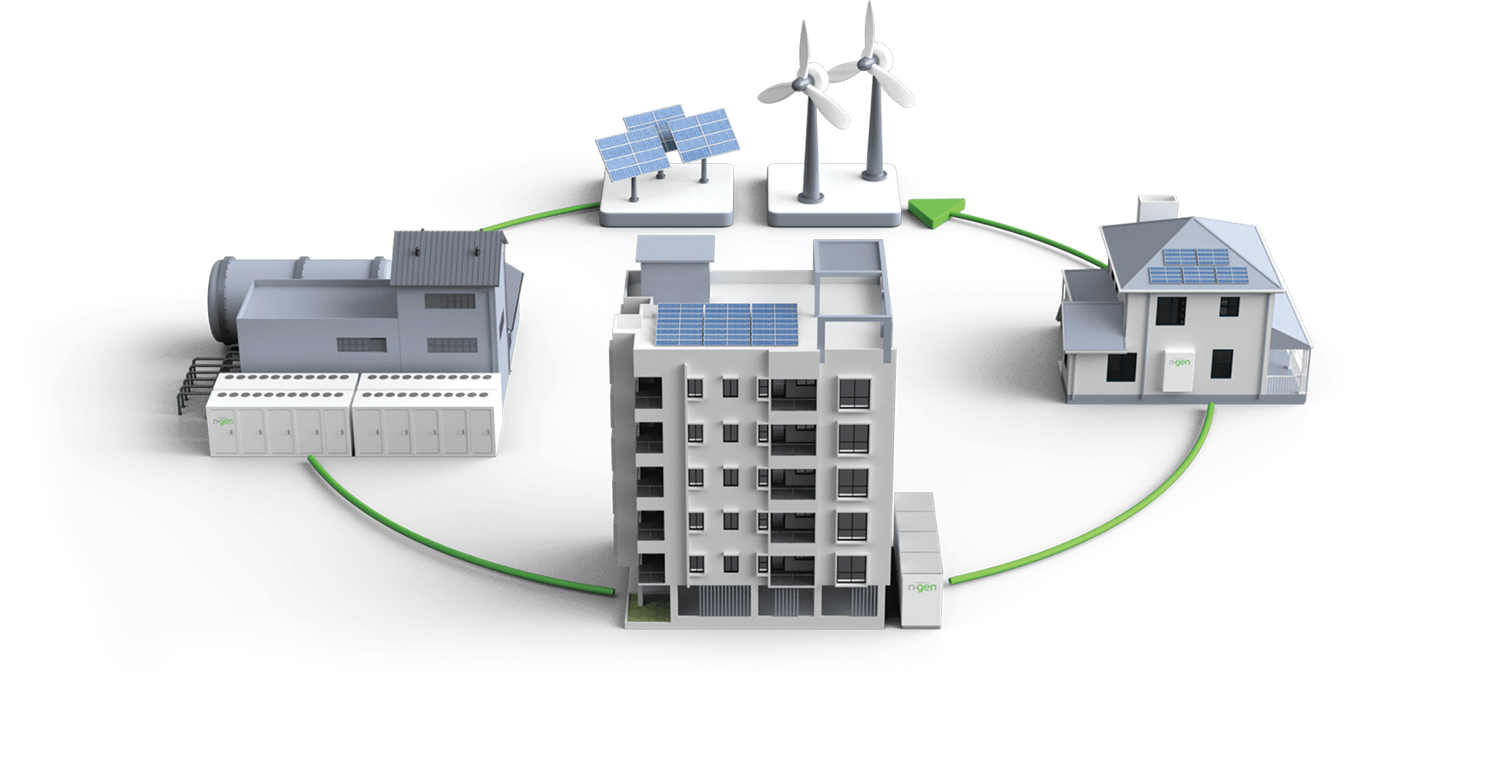
NGEN VISION
Full digitalisation of energetics
Decentralisation of European energy system
Linking energy producers, distributors, transmission system and consumers
Consumption optimisation
Increasing energy independancy
Carbon footprint reduction

Slide 4
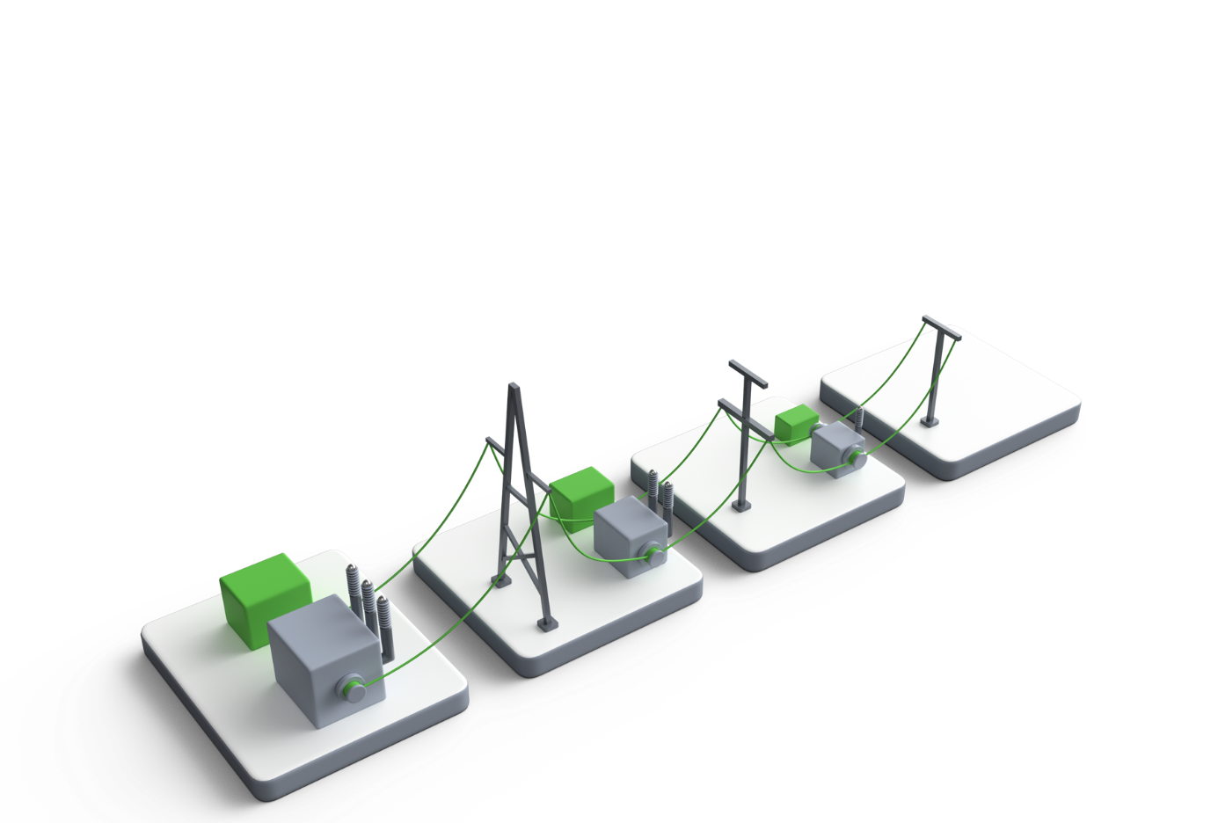
What We do?
TSO
Electricity producers from renewables
Ancillary services
aFRR
mFRR
Production shifting
Balancing
Providing services to TSO

Slide 5
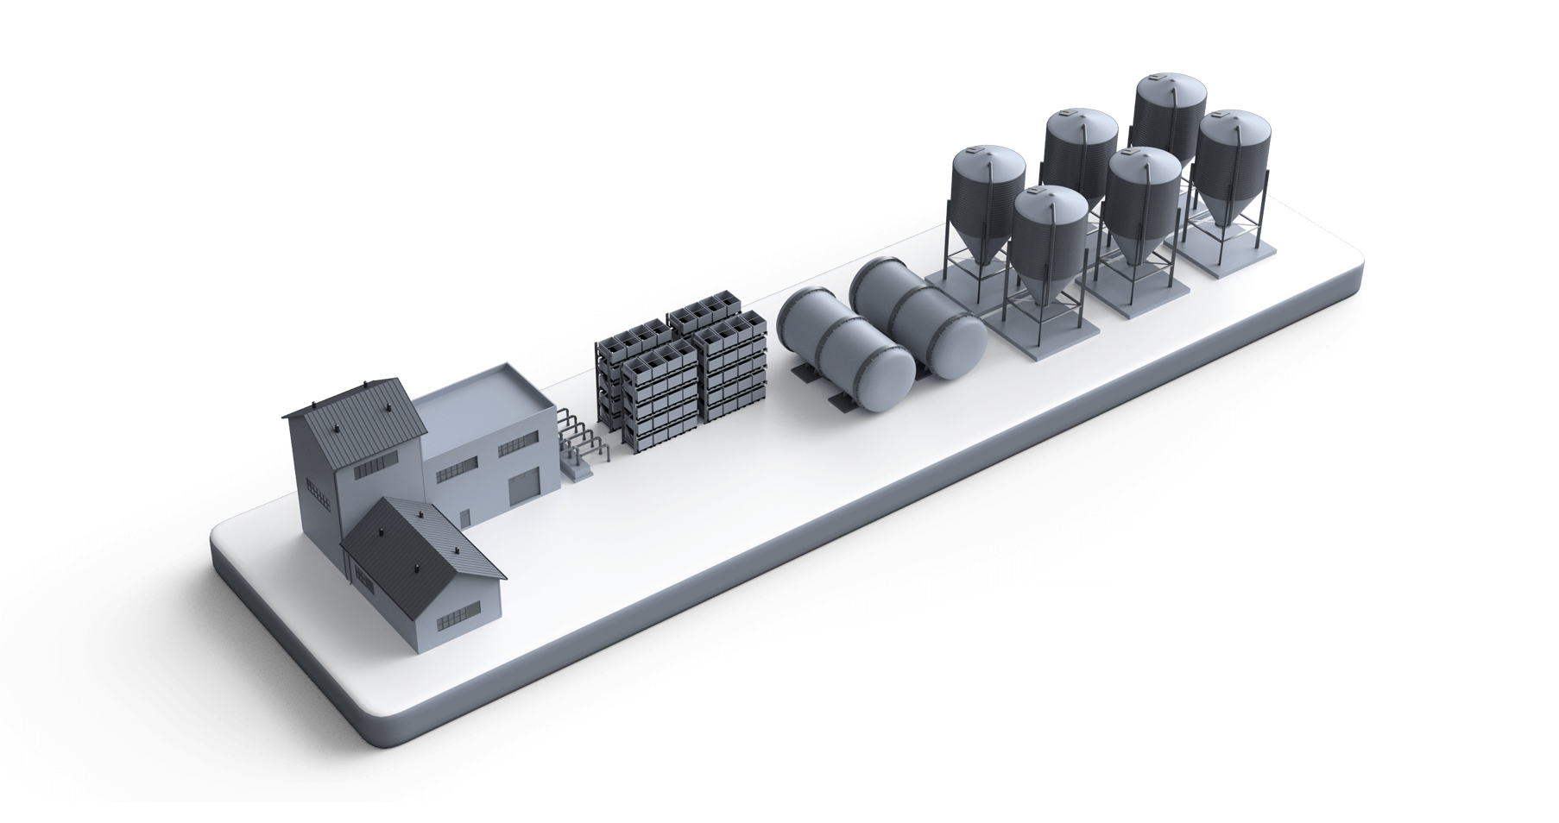
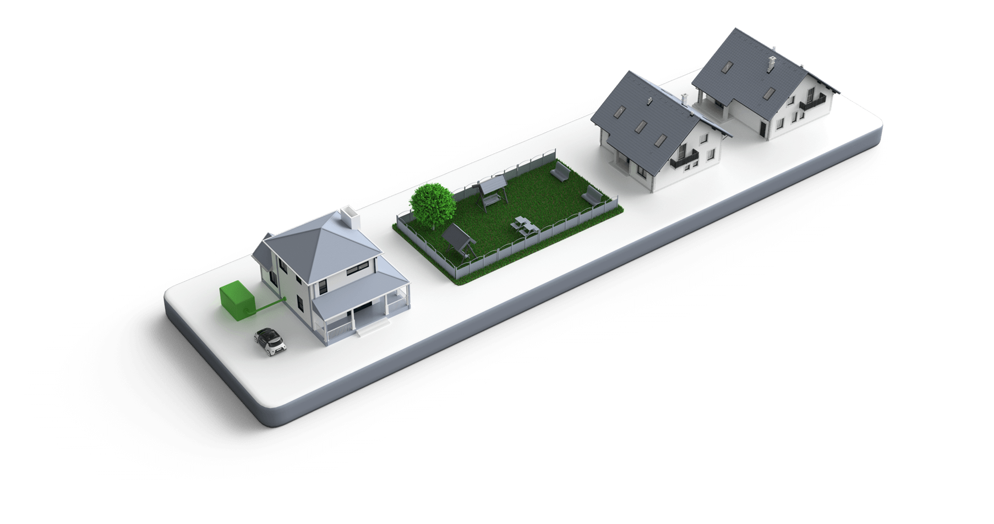
What We do?
B2B, Industrial sector
Peak shaving
Load shifting
Backup power
Using dynamic prices
Demand-response
Households
Self-sufficient system
Peak shaving
Load shifting
Backup power
Using dynamic prices
Demand-response

Slide 6
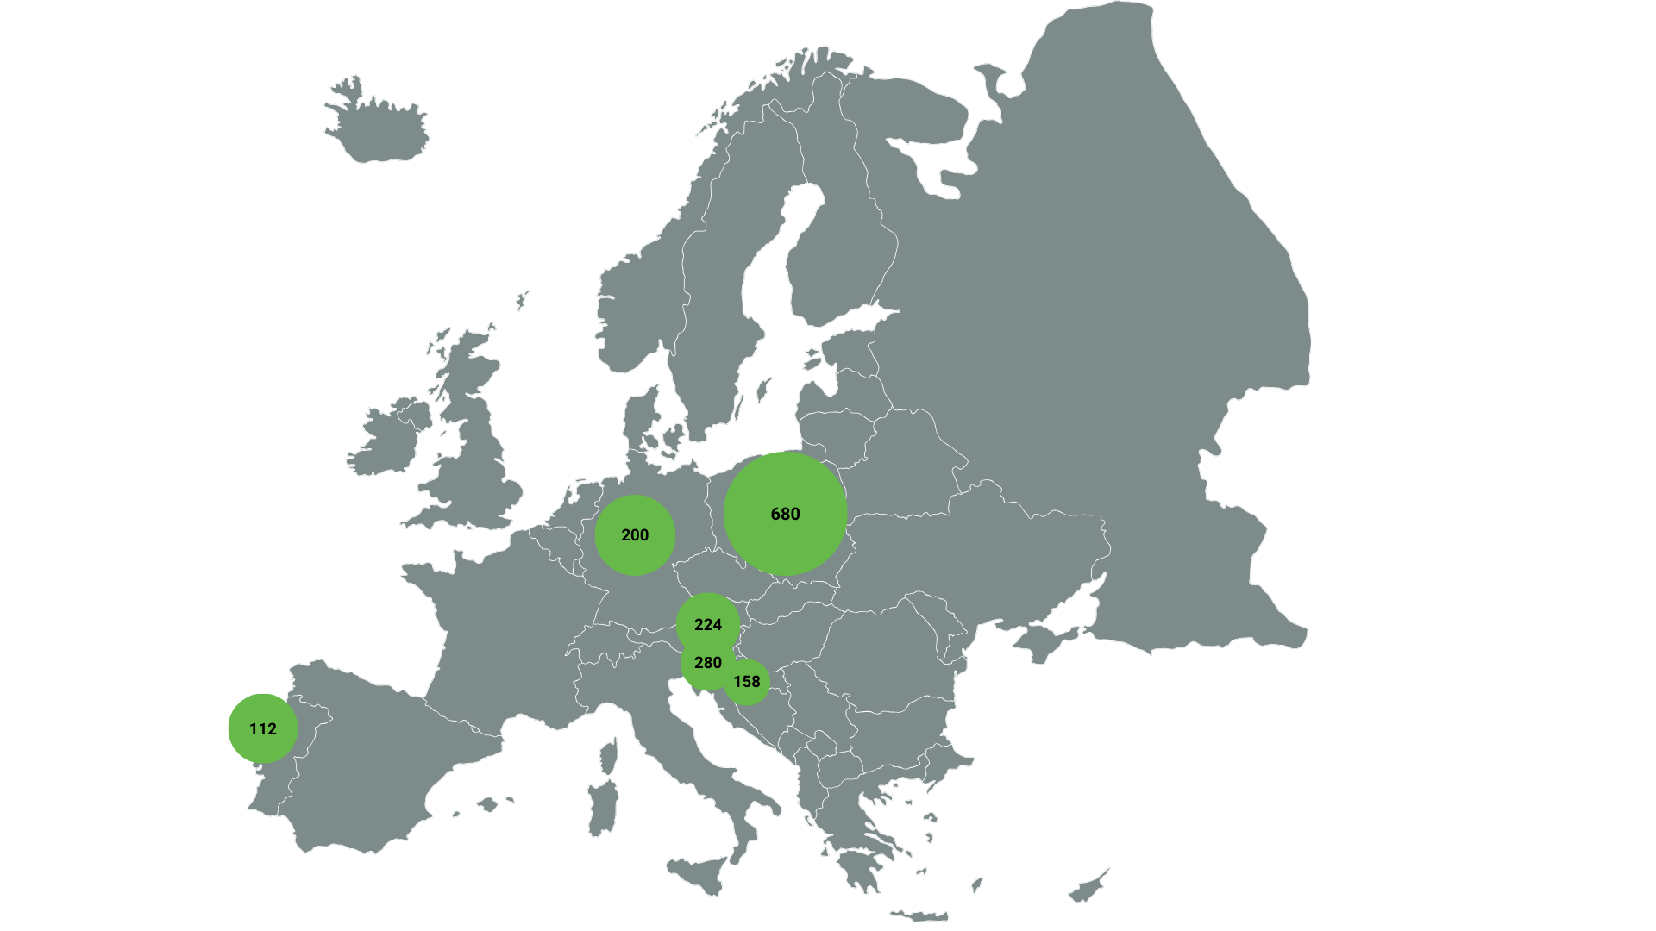

Start of construction 2024/25/26
Expected start of construction
1,6
GWh of built systems until 2026

Slide 7
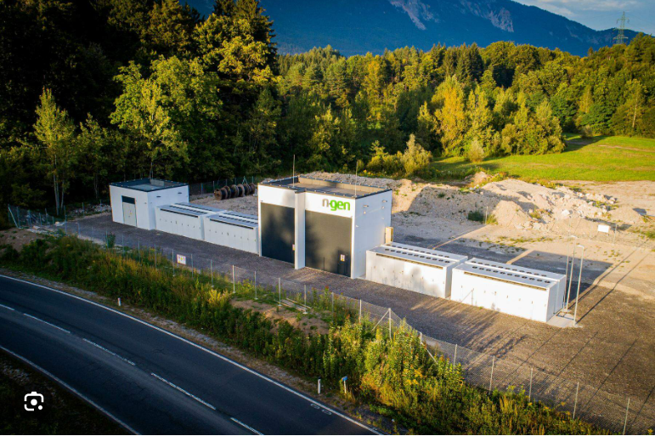
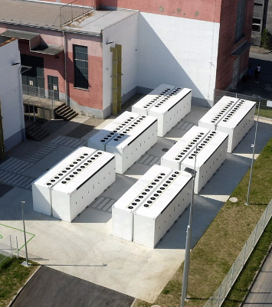
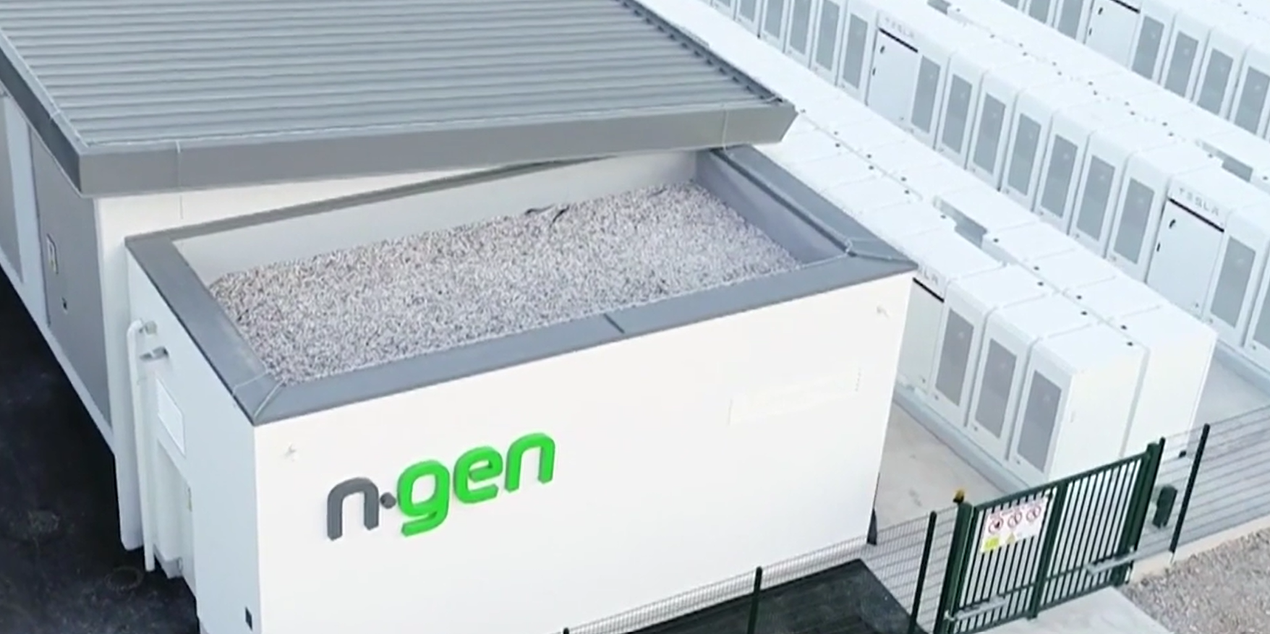
Austria/Arnoldstein
20 MWh (in operation)
Slovenia/Maribor
66 MWh (in operation)
e
Slovenia/Jesenice
22 MWh (in operation)

Slide 8
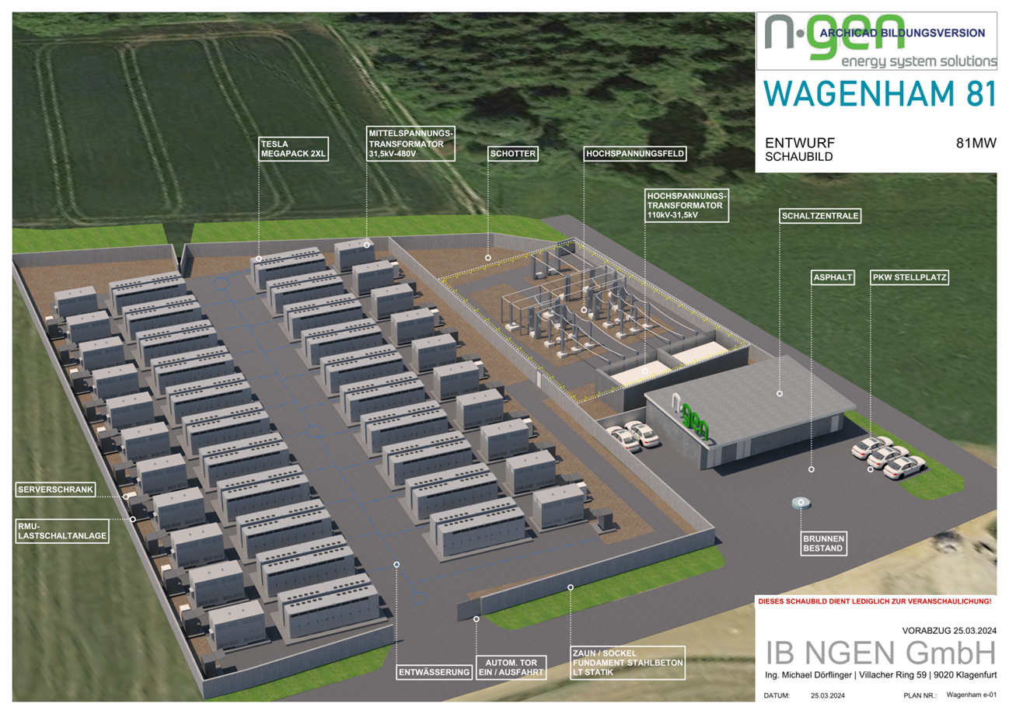
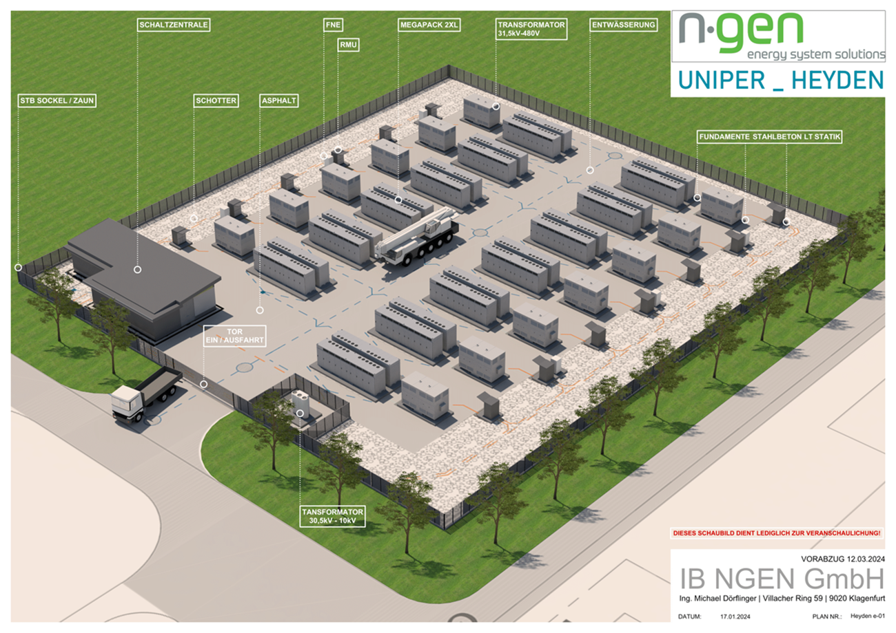

Slide 9
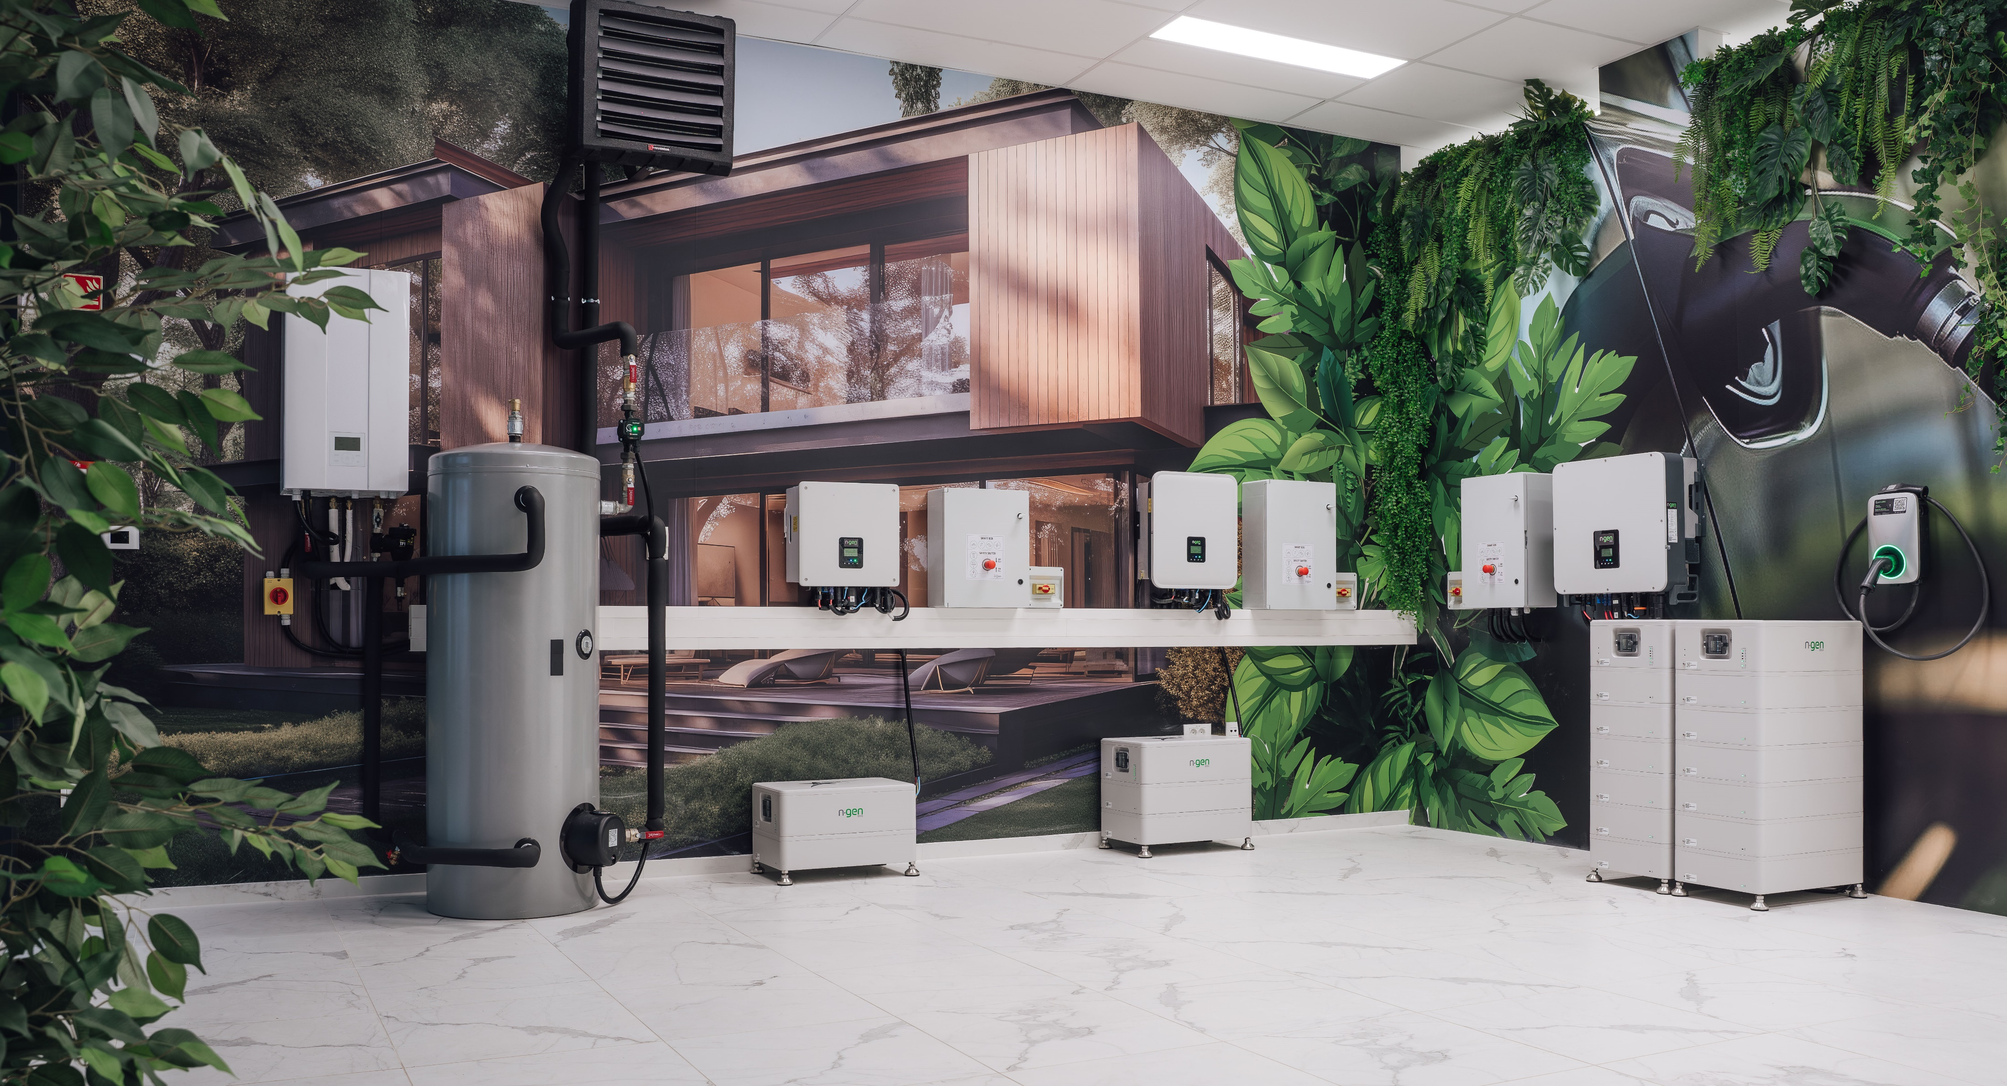
e
SG demo center

Slide 10
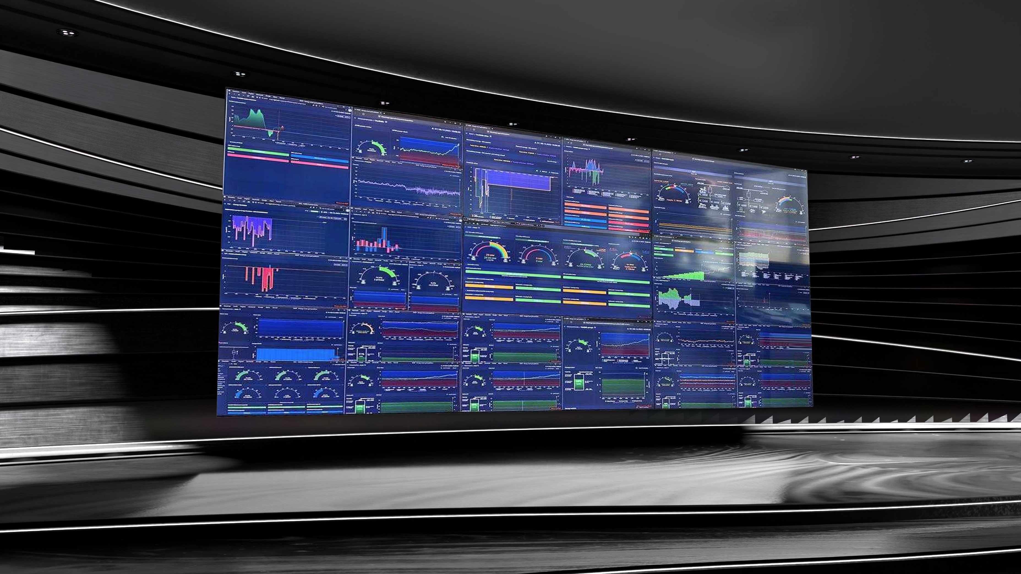

Slide 11
THANK YOU FOR YOUR ATTENTION
For more info go to: www.ngen-group.eu

